Slide 1
PANEL DISCUSSION
A proposition by C. Olabe - EICF Executive Director

Slide 3
THE WORLD CONFERENCE
1.- ORIGIN
2.- PURPOSE & SCOPE
3.- THE HISTORICAL EVOLUTION
4.- 14TH WCIC, PARIS 2016
5.- WHY PARTICIPATE
6.- HOW TO PARTICIPATE

Slide 4
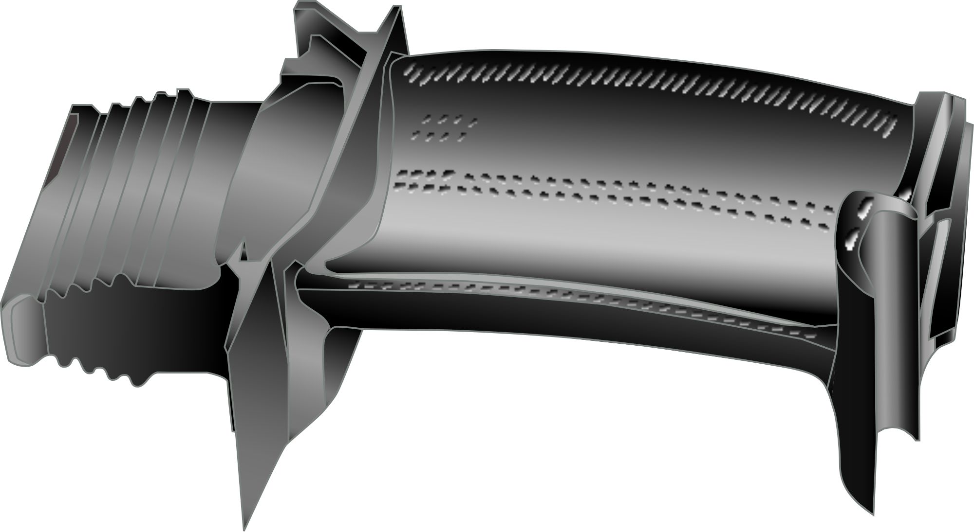
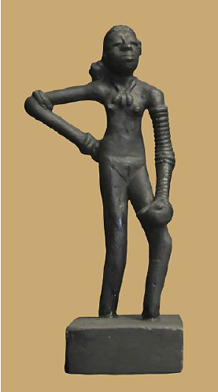
AN ANCIENT TECHNOLOGY DEVOTED MOSTLY TO ART & DECORATION
PROVIDES THE SOLUTION TO THE JET ENGINE…
AND BEYOND………
TECH DEVELOPMENT
1930…
2015
TIMELINE
3000 BC…

Slide 5
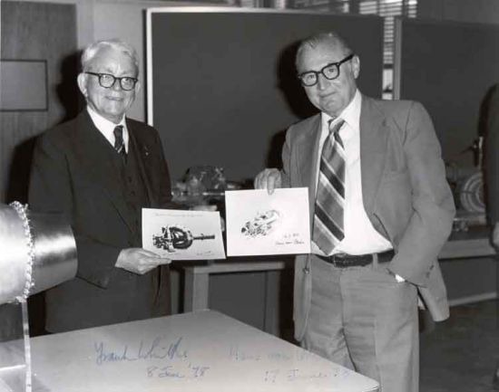

Slide 6
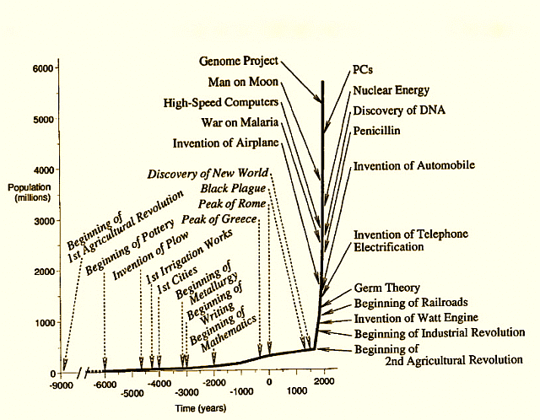
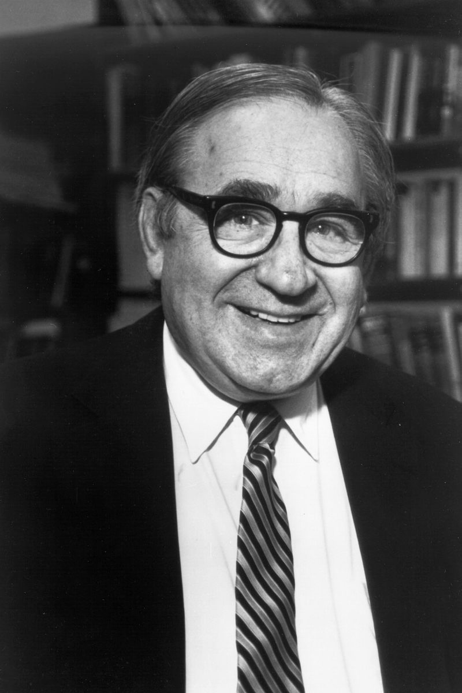

Slide 7
1.- ORIGIN
INDUSTRIES AND ASSOCIATIONS ORGANIZE CONFERENCES COMBINING SPEAKERS FROM ALL THE INDUSTRIALIZED WORLD

Slide 8
2.- PURPOSE & SCOPE
THE INTERCHANGE OF EXPERIENCES AND KNOWLEDGE WITHIN A BROADER HORIZON
TO SUPPORT BOOSTING ON THEIR OWN DEVELOPMENT
TO IDENTIFY THE STATE OF THE ART
TO UNDERSTAND MARKETS DEVELOPMENT
WITH A GLOBAL PERSPECTIVE

Slide 9
3.- THE HISTORICAL EVOLUTION
Early Investment Casting Associations, relate to the industrialized world :
USA INVESTMENT CASTING INSTITUTE ICI
1956 EUROPE EUROPEAN INVESTMENT CASTER´S ASSOCIATION EICA
UK BRITISH INVESTMENT CASTING TRADE ASSCIATION BICTA
EUROPE EUROPEAN INVESTMENT CASTER´S FEDERATION EICF
JAPAN JAPAN FOUNDRY SOCIETY * JFS
*JFS INTEGRATED IN 2009 ALL EXISTING CASTING ASSOCIATIONS IN JAPAN

Slide 10
3.- THE HISTORICAL EVOLUTION

Slide 11
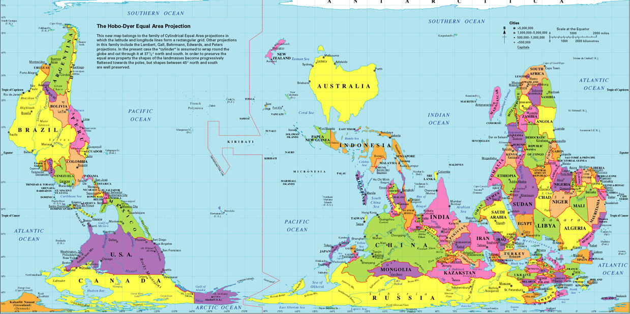

Slide 12
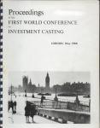
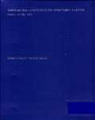
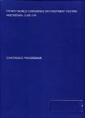
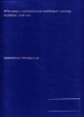
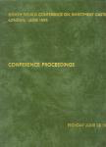
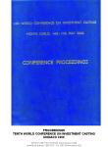
WCIC PROCEEDINGS
1ST LONDON 2ND DUSSELDORF 3RD PARIS 4TH AMSTERDAM 5TH FLORENCE
6TH WASHINGTON 7TH MUNICH 8TH LONDON 9TH SAN FRANCISCO 10TH MONTE CARLO

Slide 13
12ND WCIC
PROCEEDINGS
DALLAS
2008
13RD WCIC
PROCEEDINGS
KYOTO
2012
11ST EDINBURGH 12ND DALLAS 13RD KYOTO
14TH WCIC
PARIS
NEXT DESTINATION →

Slide 14
THE LONG ROAD TO AN ESTABLISHED WCIC ORGANIZATION
UNTIL 1980 , WCIC WERE ORGANIZED BY BICTA AND EICF

Slide 15
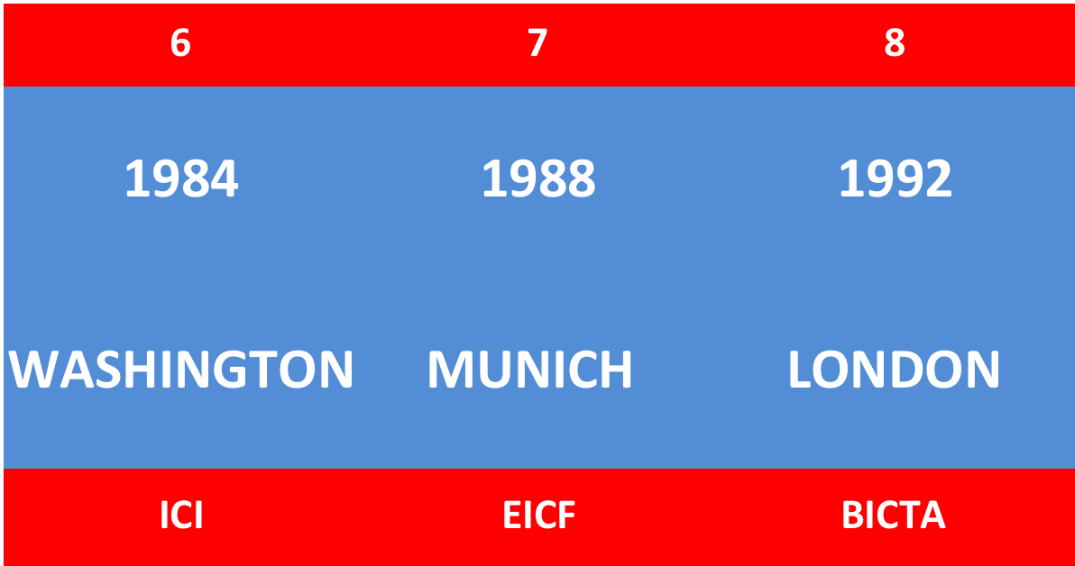
THE LONG ROAD TO AN ESTABLISHED WCIC ORGANIZATION
BY 1980 , ICI AGREED TO ENTER INTO THE WCIC CIRCUIT
BICTA, EICF , ICI

Slide 16
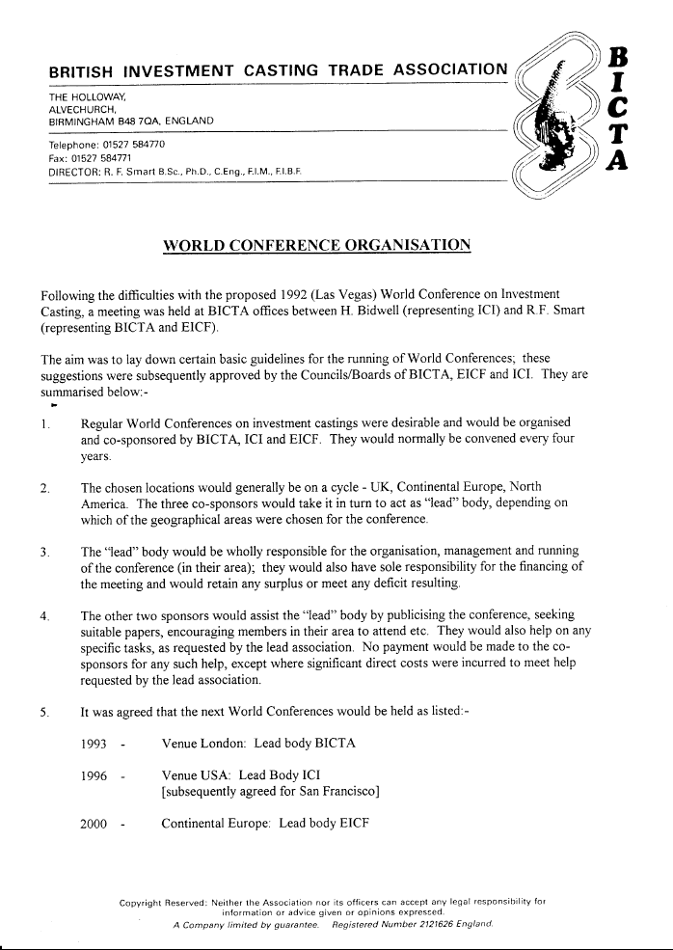
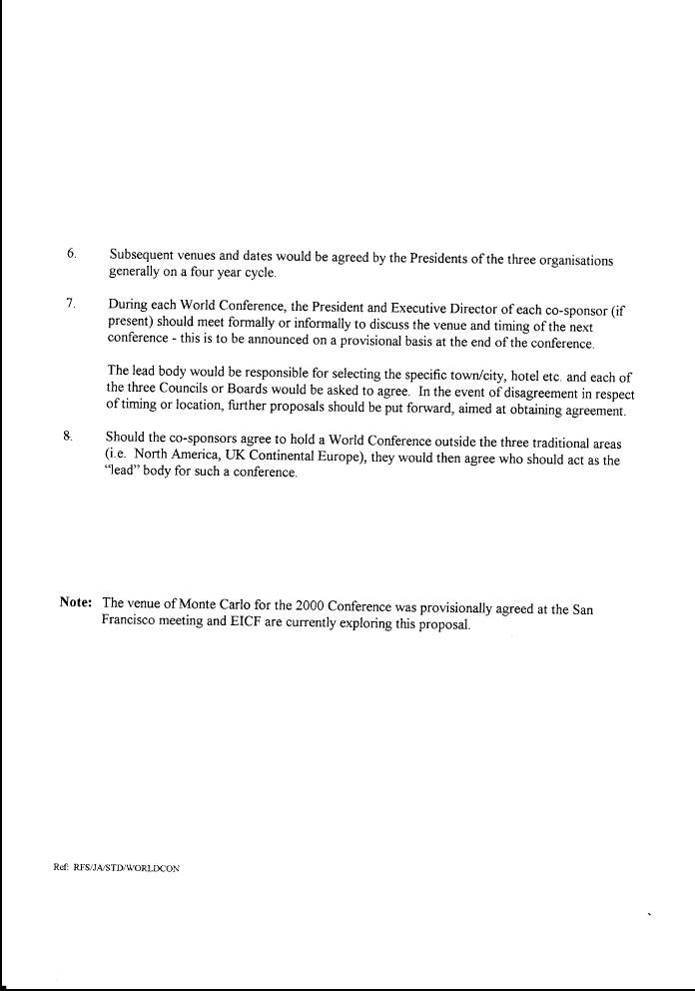
SOMETIME IN EARLY 1990s , ICI (HENRY BIDWELL) AND BICTA /EICF (BOB SMART) AGREED THE BASIC GUIDELINES FOR THE RUNNING OF THE WORLD CONFERENCES SUBSEQUENTLY APPROVED BY THE RESPECTIVE BOARDS

Slide 17
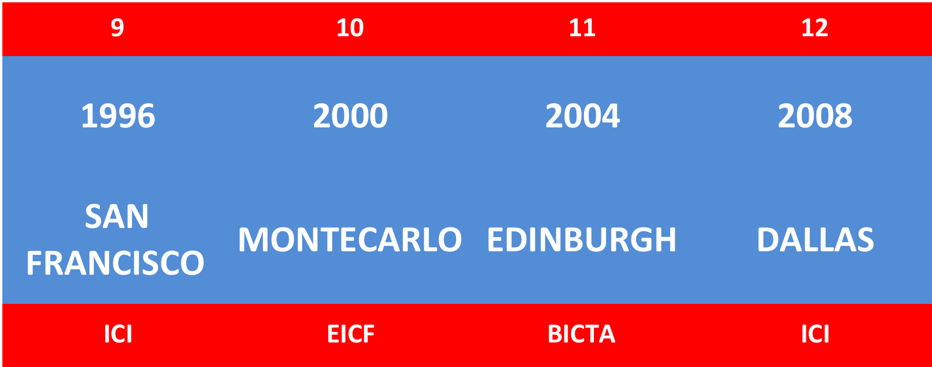
THE GUIDELINES WERE APPLIED UNTIL THE DISCUSSION IN DALLAS TO INTRODUCE INTO THE CIRCUIT THE FAR EAST, BY INCORPORATING THE JFS (JAPAN FOUNDRY SOCIETY)
CONVERSATIONS LED BY MICHAEL PERRY AND DAVID FORD / C.OLABE
A MEETING IN KRAKOW 2010 (JFS/EICF/EICF) CLOSED THE DEAL

Slide 18
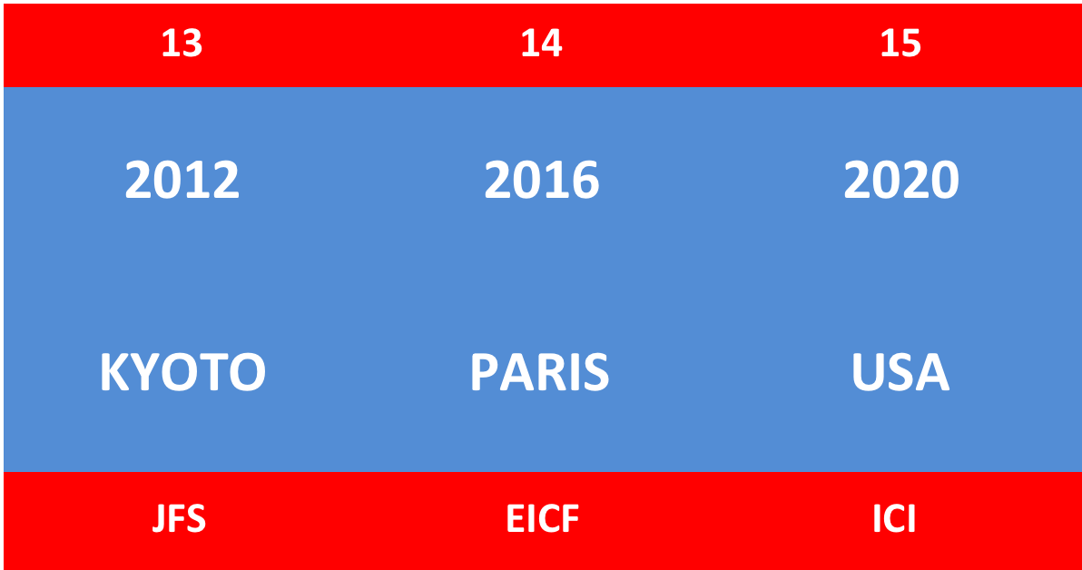
2012 WAS THE FIRST WCIC IN THE FAR EAST
FROM THEN ONWARDS THE ICI/EICF/JFS DEAL WORKS
EVERY FOUR YEARS

Slide 19
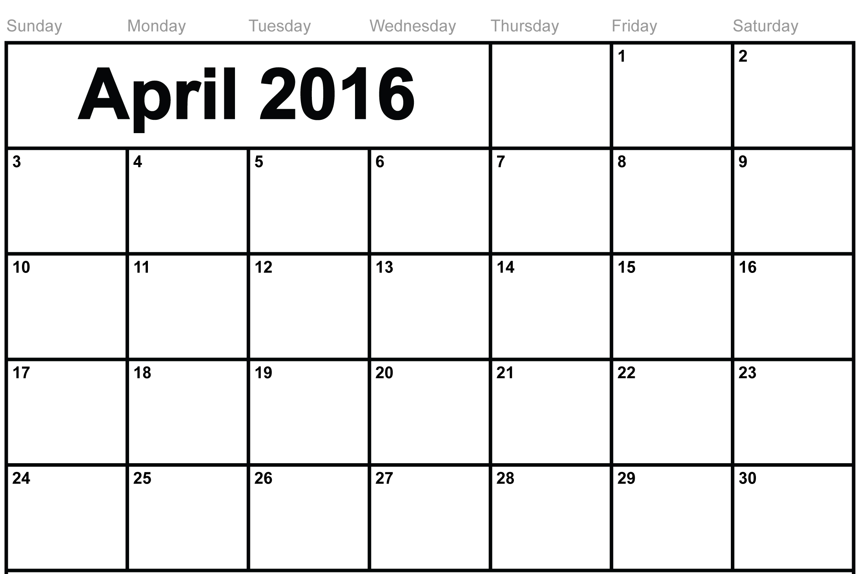
4.- 14TH WCIC, PARIS 2016

Slide 20
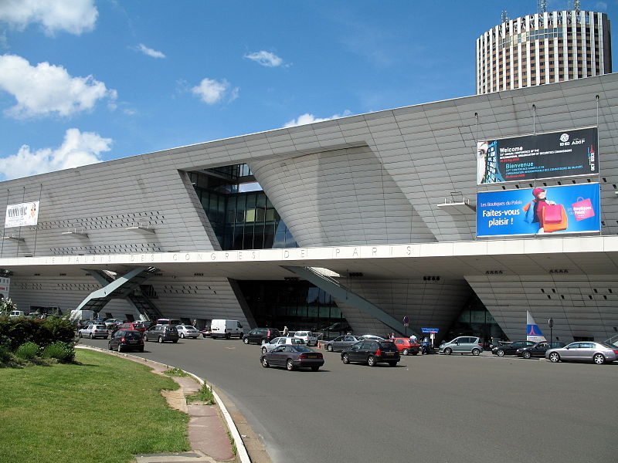
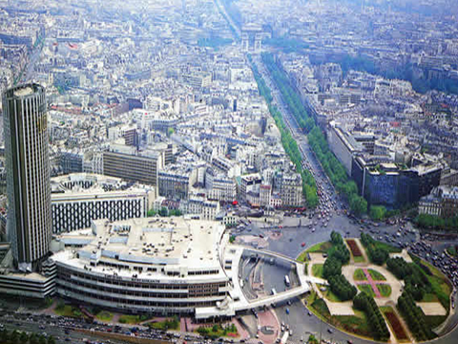
4.- 14TH WCIC, PARIS 2016
LOCATION : LE PALAIS DES CONGRÈS

Slide 21
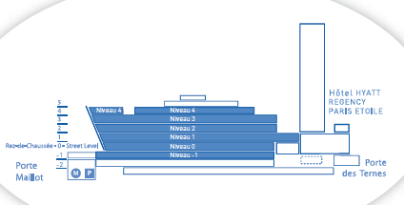
4.- 14TH WCIC, PARIS 2016
LOCATION : LE PALAIS DES CONGRÈS

Slide 22
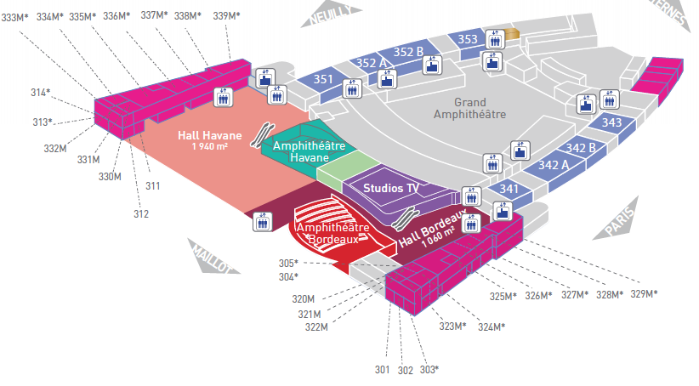
4.- 14TH WCIC, PARIS 2016
LOCATION : LE PALAIS DES CONGRÈS LEVEL 3
CONFERENCE ROOMS

Slide 23
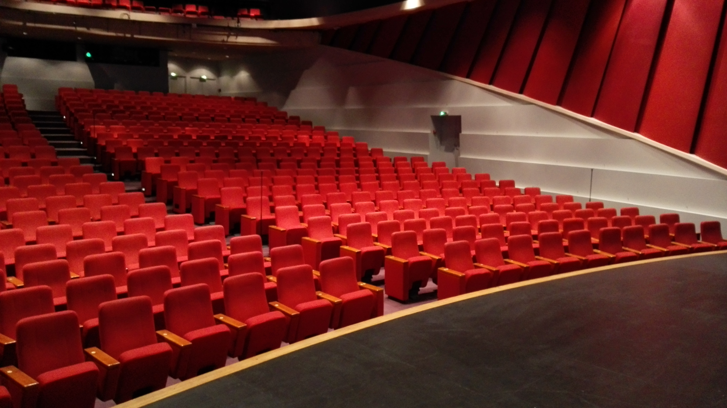
4.- 14TH WCIC, PARIS 2016
LOCATION : LE PALAIS DES CONGRÈS LEVEL 3
PLENARY SESSIONS : BORDEAUX AMPHITHEATRE

Slide 24
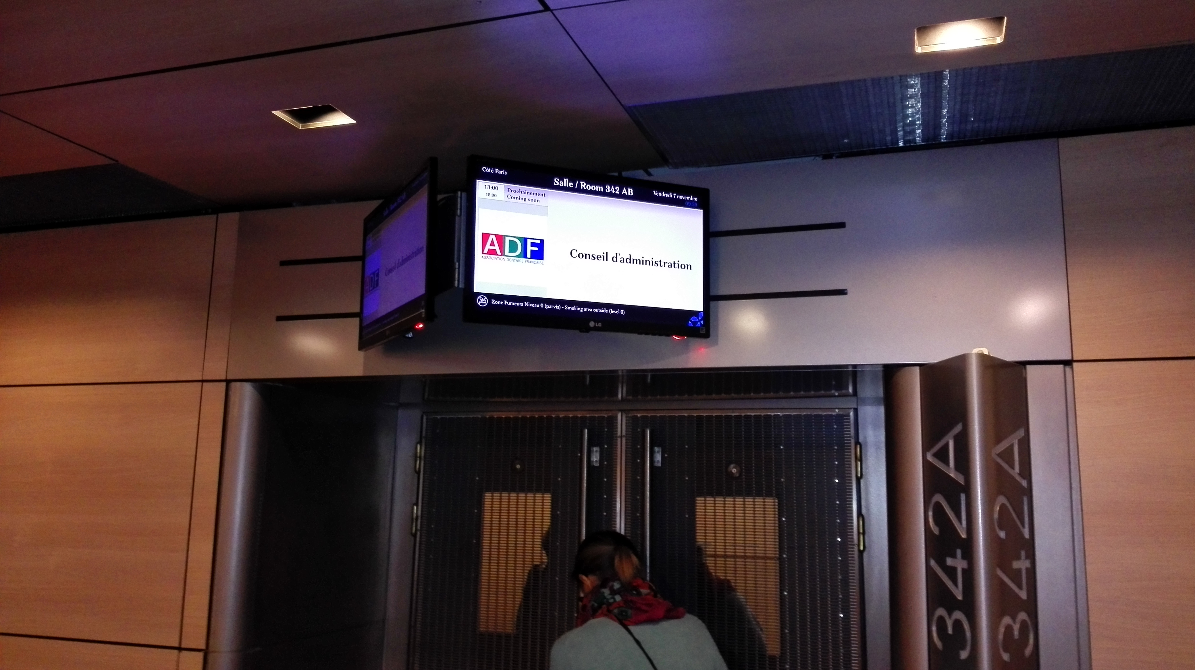
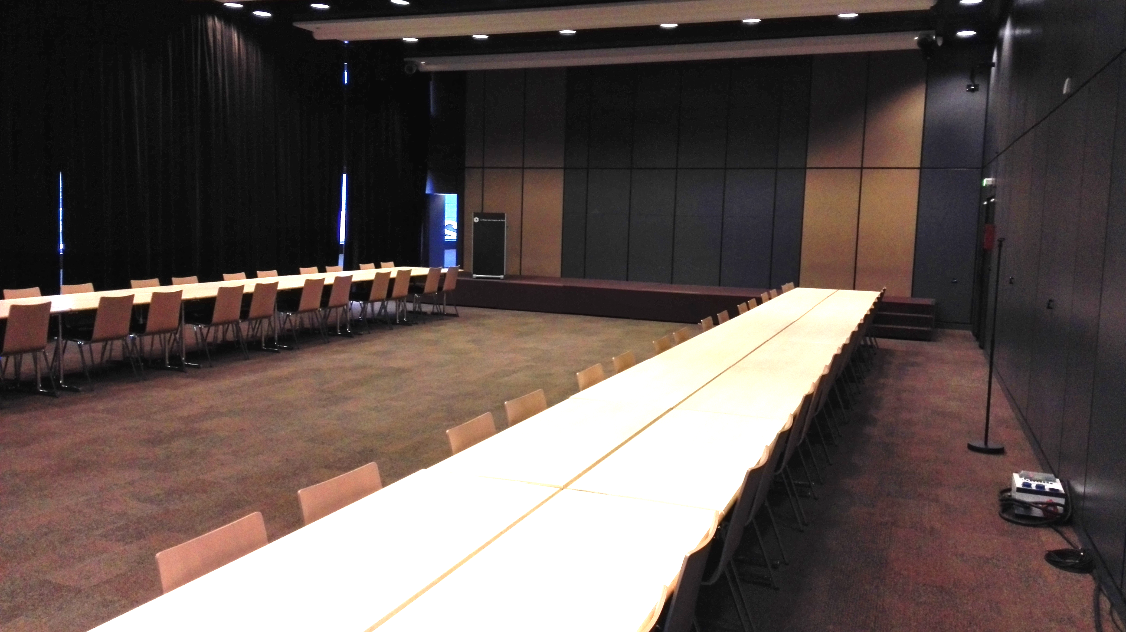
4.- 14TH WCIC, PARIS 2016
LOCATION : LE PALAIS DES CONGRÈS LEVEL 3
ROOM 342A : PARALELL SESSIONS & SEMINARS

Slide 25
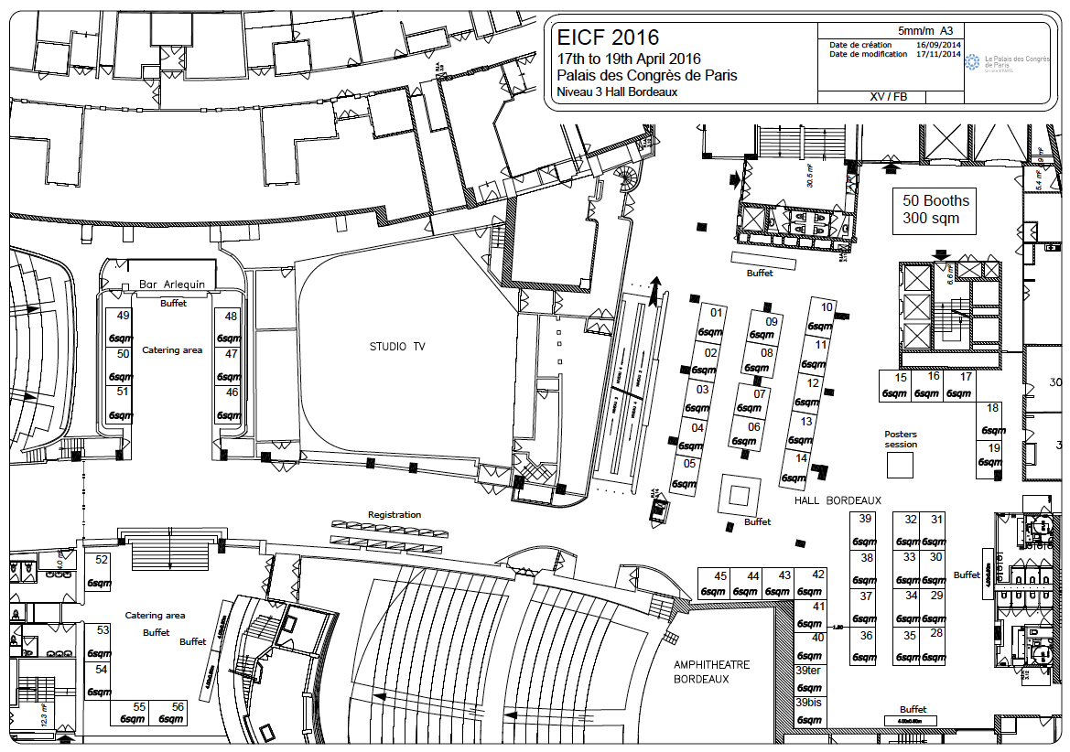
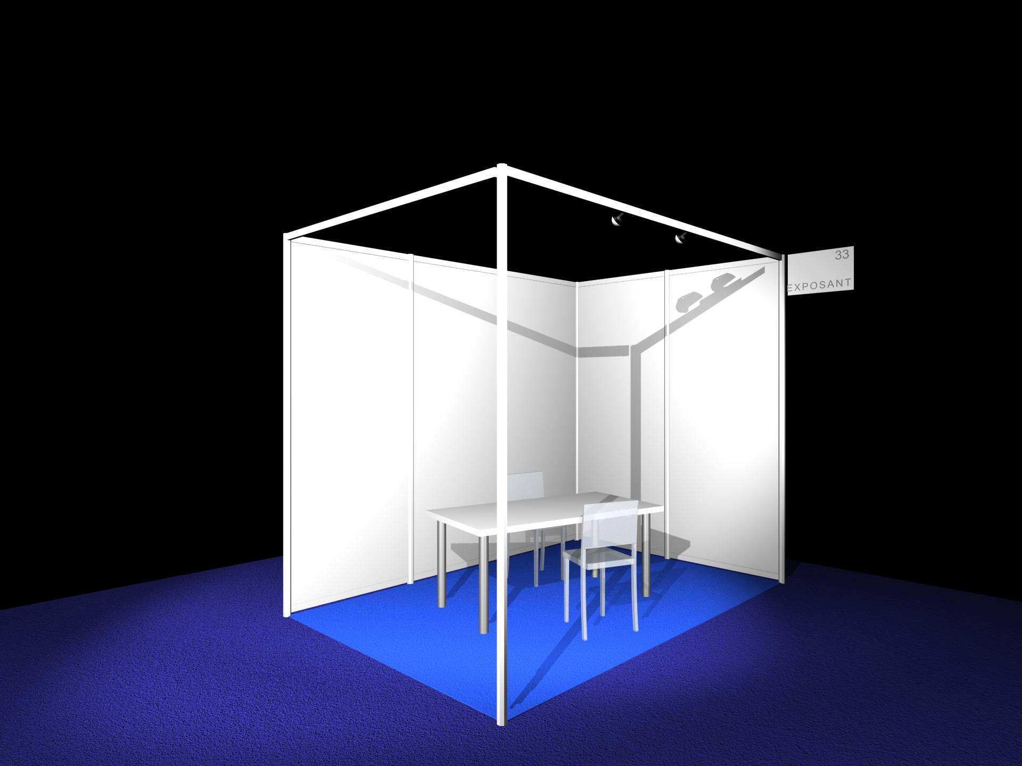
4.- 14TH WCIC, PARIS 2016
LOCATION : LE PALAIS DES CONGRÈS LEVEL 3
EXHIBITION

Slide 26
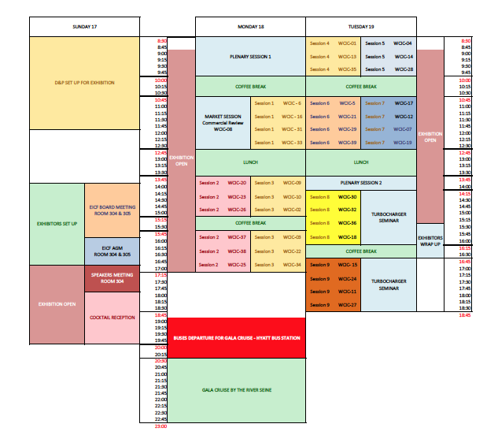
4.- 14TH WCIC, PARIS 2016
LOCATION :
LE PALAIS DES
CONGRÈS LEVEL 3

Slide 27
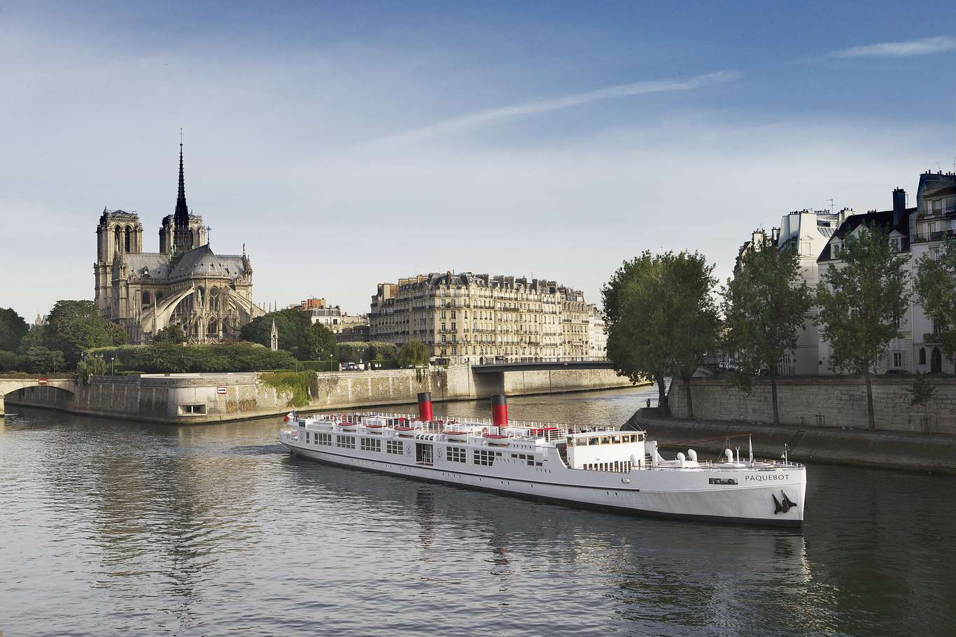
4.- 14TH WCIC, PARIS 2016
GALA DINNER : CRUISE BY THE RIVE SEINE

Slide 28
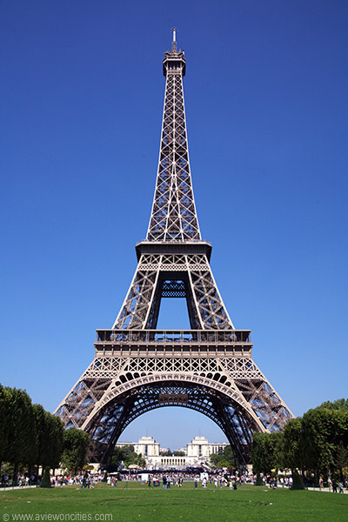
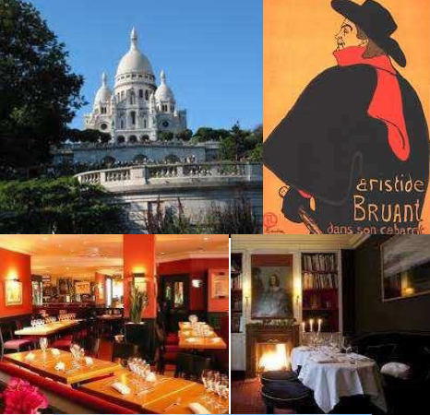
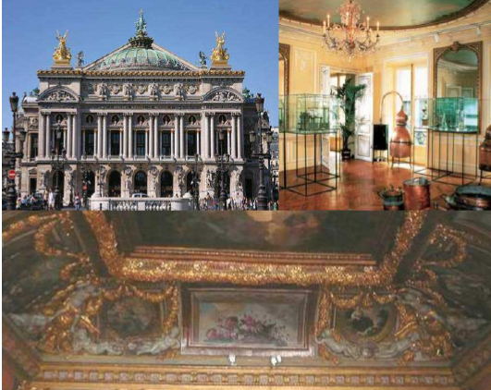
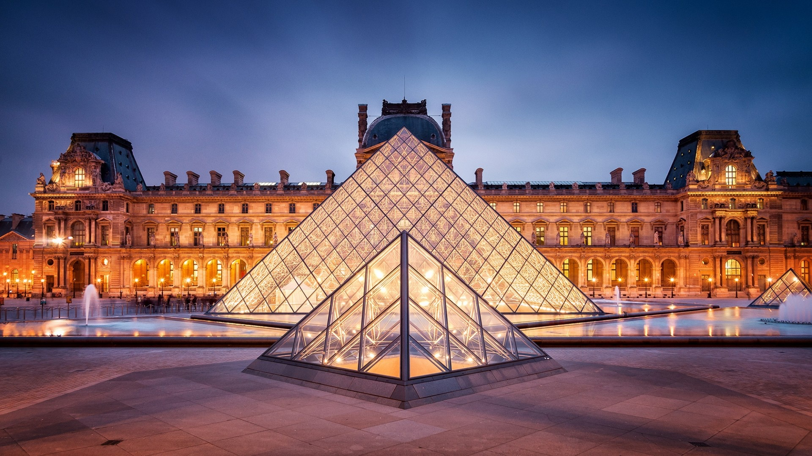
4.- 14TH WCIC, PARIS 2016
SOCIAL PROGRAMME

Slide 29
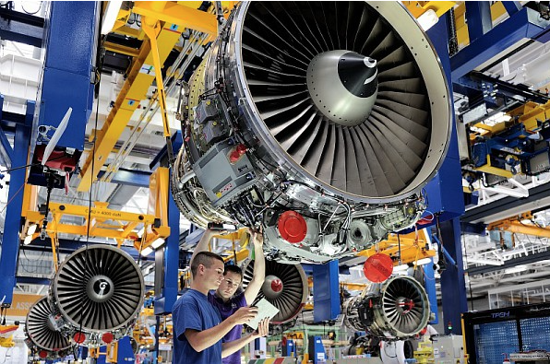
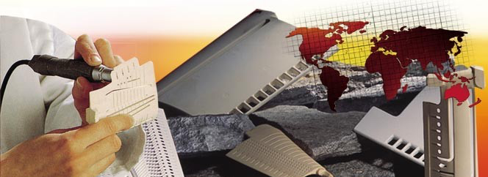
4.- 14TH WCIC, PARIS 2016
INDUSTRIAL VISITS
CTIF est un centre de recherches et développement français spécialisé en fonderie et en matériaux et produits métalliques. Au cœur de la filière de transformation des matériaux, il œuvre en permanence à relier la recherche appliquée au monde industriel.

Slide 30
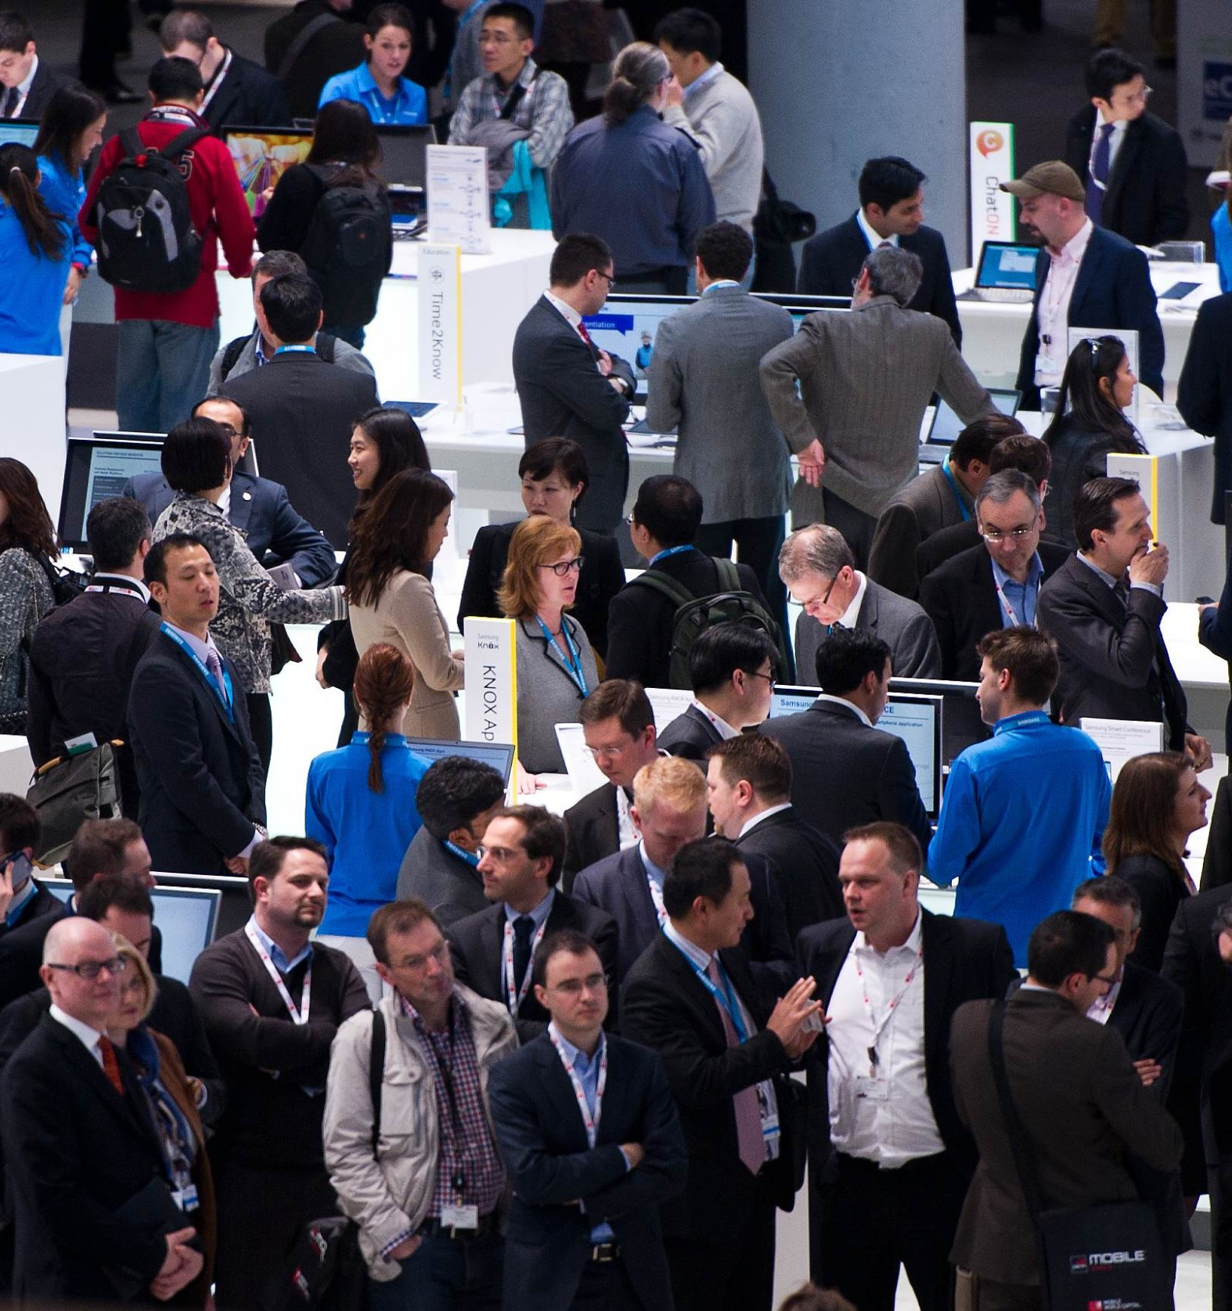
5.- WHY PARTICIPATE
WCIC are unique opportunities for IC stakeholders to combine :
Global market statistics
Global market trends and demand evolution
Customer voice listening
State of the art technologies
Alternative technologies evolution
Process equipment innovations
Product materiel innovations
Management techniques
Information Technology Applications
Process Modeling Software & Database build up
Research projects
Social responsibility trends and application
Networking
Socializing

